Slide 1
Internet Telecom Churn rates
Jorge Merida

Slide 2
AGENDA
Key Takeaways​
Research Question
Dataset Selection
EDA
Modeling
​Evaluation
Results
Conclusion

Slide 3
Key Takeaways
Due to lacking evidence in this dataset, a project plan to improve churn rates remains incomplete.

Slide 4
Research question
Can I group consumers by tenure, and find out how many churn within 1 year as opposesed to post 1 year?

Slide 5
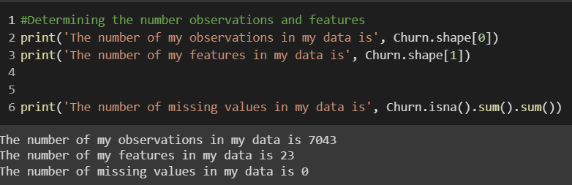
Data selection
A telecom dataset with internet, phone line sales, customer churn rates, and contract details.
Customer contract types, and customer tenure details were reviewed.
There were 7,043 observations and 23 features

Slide 6
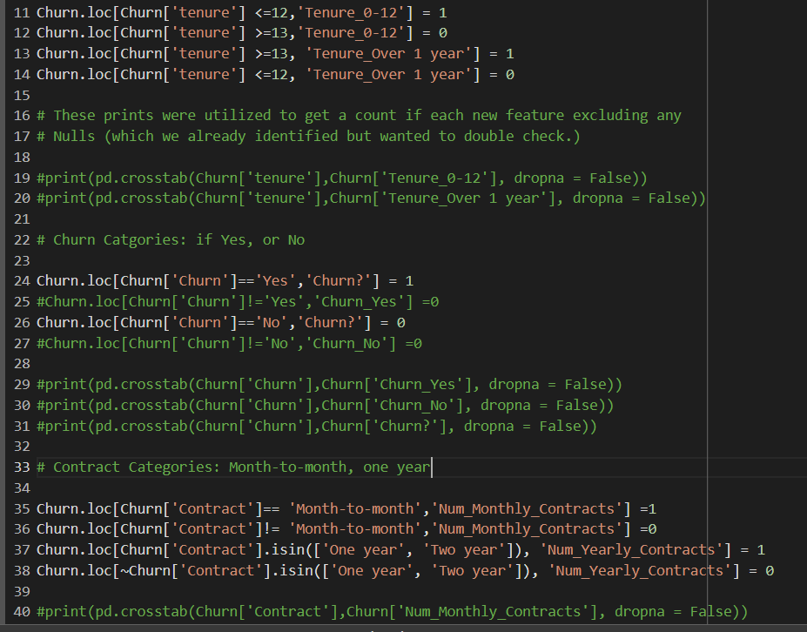
Exploratory data analysis
My target categorical values were utilized in classification and logistic regression modeling.
Binary encoding was used to create the 4 categorical features.
No missing values in the data set but data wrangling was a bit extensive.

Slide 7
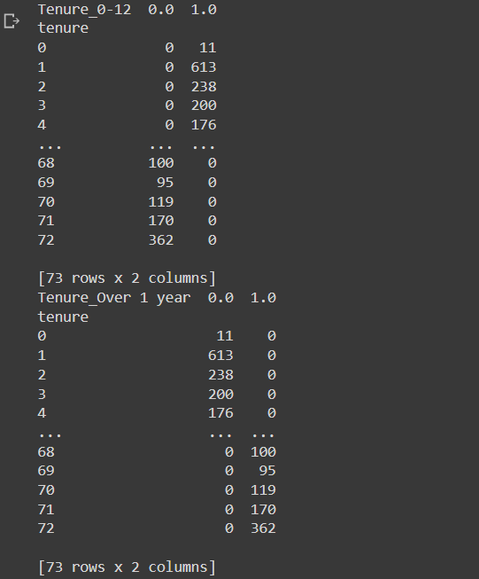
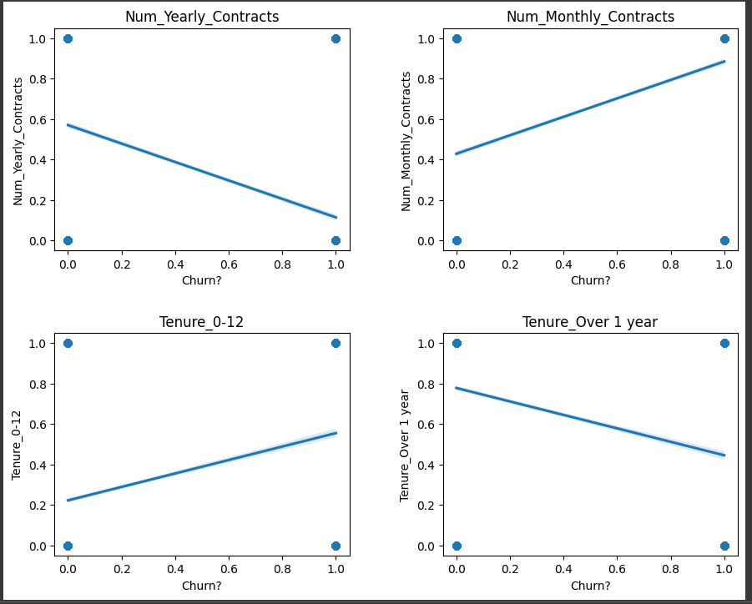
Exploratory data analysis
The new features were broken down into 4 different categories:
  Tenure: 0-12, Over 1 year
  Churn?: If a customer cancelled their service
  Contracts: Num Monthly/Yearly Contracts
In each feature values of :
  0 = No
  1 = Yes

Slide 8
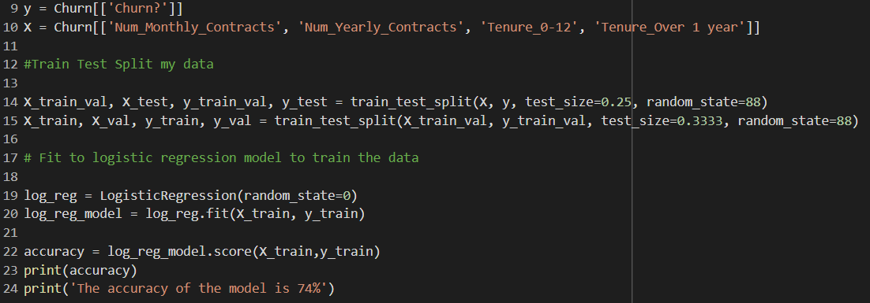
Modeling
Various categorical values were used so a classification model was used.
Logistic regression was utilized in conjunction with cross validation, but after completing this analysis I believe other models could have been used. Though I lack the specific knowledge on which others I could have tested with.

Slide 9
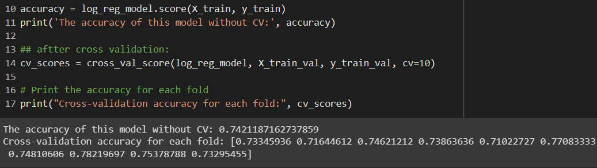
Evaluation
The accuracy of this model without CV: 0.7421187162737859
Cross-validation accuracy for each fold: [0.73345936, 0.71644612, 0.74621212, 0.73863636, 0.7102272, 0.77083333, 0.74810606, 0.78219697, 0.75378788, 0.73295455]

Slide 10
Results
Based on the results (accuracy and Cross validation) from my logistic regression model there is lacking evidence necessary to suggest a project plan.
The dataset is lacking detailed or specific features necessary for improving the accuracy of this model. I think with More time and further reasearch I could have maybe created the features I need to create a better model.
74% isn't terrible, but to suggest a project for improvement to management based on this model's results would not be wise. I would love to continue research in the future.

Slide 11
conclusion
I would say the the most difficult part of this model was definitely the modeling itself. I remember how to use the code like Train test split (to an extent) but had to watch tons of videos and even ask ChatGPT for explanations on how some of these functions to make sense of them with my thought process.
Though, it was tedious I did infact get lost in the work like I once did when I first was exposed to data science coding, and to find the passion in the work at the end of this course just felt really great!
If I had more time I'd 100% research more modeling options as well. Even though I was able to get the code to work for me I still dont think I have enough experience or real understanding on how to use modeling very well yet. Though it's inspried me to continue working on this on my own after this.

Slide 12
THANK YOU
Jorge Luis Merida
Jmerida1988@Icloud.com

